Slide 1
COMP3074 Mobile App Development I
Week 6

Slide 2
Weekly Topics
Interacting with Android’s Device Hardware.
Using the Device Sensors.
Reading Sensor Data.
Calibrating Sensors.
Determining Device Orientation.
Sensor Event Batching.
Monitoring the Battery.
Android’s Optional Hardware APIs.
Working with Bluetooth.
Working with Wi-Fi
Lab: Geo Chat app – Milestone 8

Slide 3
Weekly Objectives
Explain how to use Android’s Device Hardware including Sensors, Bluetooth and Wi-FI;
Build an android application that accesses Device Sensors, Bluetooth and Wi-FI.

Slide 4
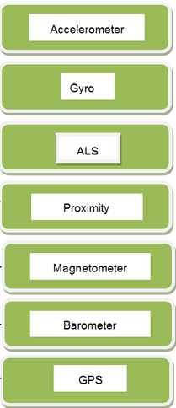
1. Interacting with Android’s Device Hardware
Android SDK
variety of APIs for accessing low-level hardware features on the device such as
magnetic and orientation sensors
light sensors
temperature sensors
battery state

Slide 5
1. Interacting with Android’s Device Hardware
Guidelines to access device hardware
Make no assumptions about the existence or availability of underlying hardware
Always check and verify optional features before trying to access hardware programmatically.
Pay special attention to exception handling and error and return value checking when working with hardware APIs.
Understand that hardware features are device resources.
Acquire them late
Release them as soon as you’re done

Slide 6

2. Using the Device Sensors
Android SDK
provides access to raw data from sensors on the device
Sensors, and their precision and features, vary from device to device
Accessing Device Sensors
SensorManager object
android.hardware.SensorManager
listens for data from the sensors
system Service

Slide 7
2. Using the Device Sensors
Sensor class
android.hardware.Sensor
defines a number of identifiers for the various sensors, e.g.
TYPE_ACCELEROMETER
Measures acceleration in three directions (values are in SI units (m/s2))
TYPE_AMBIENT_TEMPERATURE
Measures temperature
TYPE_GYROSCOPE
Measures angular orientation in three directions (values are angles in degrees)
TYPE_LIGHT
Measures ambient light (values are in SI lux units)
TYPE_MAGNETIC_FIELD
Measures magnetism in three directions; the compass
TYPE_PRESSURE
Measures barometric pressure
TYPE_PROXIMITY
Measures the distance to an object
TYPE_RELATIVE_HUMIDITY
Measures the relative humidity

Slide 8

2. Using the Device Sensors
Configuring the Android Manifest File for Sensors
Acquiring a Reference to a Sensor

Slide 9
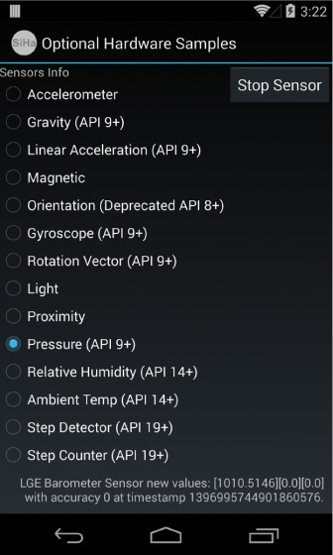
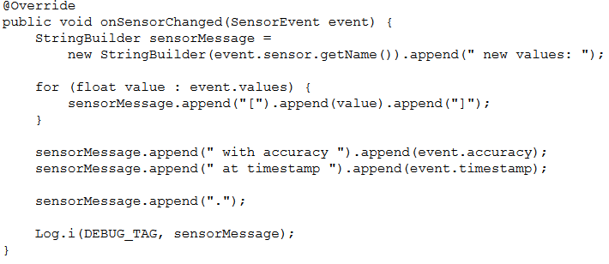
3. Reading Sensor Data
Sensor values are sent back to an application via
SensorEventListener
Reading Sensor data
Example
Book’s Code:Chapter 15 - Sensors\SimpleHardware

Slide 10

4. Calibrating Sensors
Sensor
Require calibration
ask the user to click a button to calibrate the sensor
new values can be compared against the original values to see how they have changed (delta)
When registering a sensor, the registerListener() method returns true
if the sensor is available and can be activated
Sensor values
typically quite sensitive
smoothing of the values to reduce the effects of any noise or shaking
Required for good user experience

Slide 11


5. Determining Device Orientation
SensorManager class
determine the orientation of the device
Sensor.TYPE_ORIENTATION sensor value
Deprecated
still valid on most popular devices
Recommended way
getOrientation() method of the SensorManager class
two parameters
a rotation matrix
an array of three float values
azimuth [z], pitch [x], and roll [y]
Finding True North
GeomagneticField class
android.hardware package
estimate the magnetic field anywhere on the planet
typically used to determine magnetic variation between compass north and true north

Slide 12

6. Sensor Event Batching
Android KitKat 4.4 (API Level 19+)
batching sensor updates intended for an application’s SensorEventListener.
Sensor updates are collected by the Android system and sent to your application as a batch at designated time intervals
only while the CPU is awake
allowing the device to operate in a low-power state.
If the CPU is not awake
you must take additional steps to ensure that your application’s sensor memory does not reach capacity
new sensor events will cause older ones to be removed if not executed as a batch before memory runs out.

Slide 13

7. Monitoring the Battery
Battery State
many applications do not need to know
some applications might want to change their behavior based
on the battery level
charging state
power management settings
For instance
a monitoring application
reduce the monitoring frequency when the battery is low
increase it if the device is powered by an external power source

Slide 14
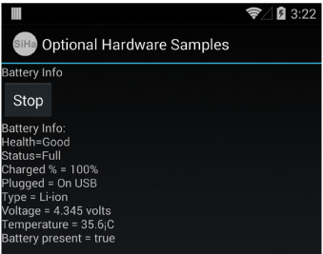
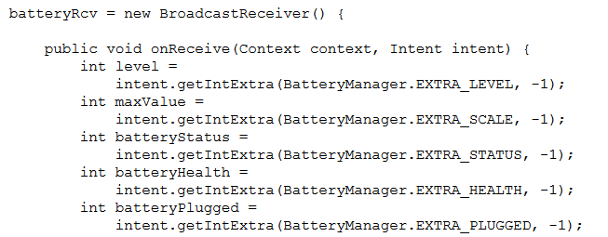
7. Monitoring the Battery
Monitoring Battery State in application
must have the BATTERY_STATS permission in AndroidManifest.xml
must register for a particular BroadcastIntent
Implement a BroadcastReceiver

Slide 15
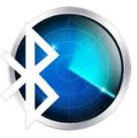
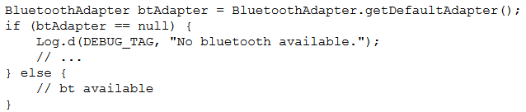
9. Working with Bluetooth
Classic Bluetooth
Checking for the Existence of Bluetooth Hardware
Manifest file
<uses-feature android:name="android.hardware.bluetooth" />
Enabling Bluetooth
Fire off the BluetoothAdapter.ACTION_REQUEST_ENABLE intent
Call the BluetoothAdapter enable() method
should be used only by applications that need to explicitly enable the Bluetooth radio
requires the BLUETOOTH_ADMIN permission
Make an Android device discoverable
also automatically enables Bluetooth
firing off the BluetoothAdapter.ACTION_REQUEST_DISCOVERABLE intent

Slide 16
8. Android’s Optional Hardware APIs
Android SDK provides a variety of APIs for accessing low-level hardware features on the device
Wi-Fi
Near Field Communication (NFC)
Bluetooth radios
a variety of USB connectivity options
Example
Book’s Code:
Chapter 16 - Hardware APIs\SimpleBluetooth
Chapter 16 - Hardware APIs\SimpleWireless

Slide 17

9. Working with Bluetooth
Bluetooth
Short range 10m
Bluetooth APIs
available since API Level 5
not all Android devices have Bluetooth hardware
popular consumer feature
Android 4.3 (API Level 18)
introduced support for Bluetooth Low Energy (BLE)
uses a lot less power

Slide 18
9. Working with Bluetooth
Android applications can:
Scan for and discover Bluetooth devices and interact with the Bluetooth adapter
Establish RFCOMM connections and transfer data to and from devices via data streams
Maintain point-to-point and multipoint connections with Bluetooth devices and manage multiple connections
Connect to and communicate with Bluetooth Low Energy peripheral devices

Slide 19
9. Working with Bluetooth
Classic Bluetooth
BluetoothAdapter class
Bluetooth radio hardware on the local device
BluetoothDevice class
represents a remote Bluetooth device
BluetoothServerSocket class
used to open a socket to listen for incoming connections and provides a BluetoothSocket object when a connection is made.
BluetoothSocket class
used by the client to establish a connection to a remote device.
Bluetooth LE
BluetoothManager class
used to acquire the BluetoothAdapter using the getSystemService() method passing in the Context.BLUETOOTH_SERVICE value.
BluetoothAdapter class
requires implementing the LeScanCallback interface to access the BluetoothDevice object using the onLeScan() method call
BluetoothDevice class
requires calling the connectGatt() method to connect to a peripheral Bluetooth LE device.

Slide 20


9. Working with Bluetooth
Classic Bluetooth
BluetoothAdapter class
Bluetooth radio hardware on the local device
BluetoothDevice class
represents a remote Bluetooth device
BluetoothServerSocket class
used to open a socket to listen for incoming connections and provides a BluetoothSocket object when a connection is made.
BluetoothSocket class
used by the client to establish a connection to a remote device.
Bluetooth LE
BluetoothManager class
used to acquire the BluetoothAdapter using the getSystemService() method passing in the Context.BLUETOOTH_SERVICE value.
BluetoothAdapter class
requires implementing the LeScanCallback interface to access the BluetoothDevice object using the onLeScan() method call
BluetoothDevice class
requires calling the connectGatt() method to connect to a peripheral Bluetooth LE device.

Slide 21
9. Working with Bluetooth
Classic Bluetooth
Querying for Paired Devices
Discovering Devices
New Bluetooth devices must be discovered and paired to the adapter before use
use the BluetoothAdapter to start and stop the discovery process
startDiscovery() method starts the discovery process asynchronously
requires the android.permission.BLUETOOTH_ADMIN permission
register to receive broadcasts for the following Intent actions
ACTION_DISCOVERY_STARTED
ACTION_FOUND
Occurs each time a remote Bluetooth device is found
ACTION_DISCOVERY_FINISHED

Slide 22
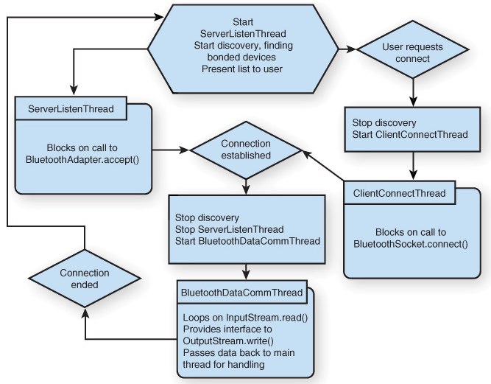
9. Working with Bluetooth
Classic Bluetooth
Establishing Connections between Devices

Slide 23

10. Working with Wi-Fi
Wi-Fi features
Use Wi-Fi system service to find and connect to various Wi-Fi networks
Use Wi-Fi Direct to facilitate connections
Wi-Fi Direct
relatively new standard
attempts to solve the problems and difficulties with ad hoc Wi-Fi
configuration and connection management
introduced in Android 4.0 (API Level 14).
host Wi-Fi Direct device basically becomes an access point
used to connect the two devices
Wi-Fi Direct vs Bluethooth
longer range
faster data communications
simpler networking

Slide 24

10. Working with Wi-Fi
Wi-Fi Direct
peer-to-peer Wi-Fi package
android.net.wifi.p2p.
WifiP2pManager class
configure several callback classes
used to asynchronously get the status of requests you make
configure a broadcast receiver to handle various notifications
state of Wi-Fi Direct changes
Permissions
no distinction between regular Wi-Fi and Internet access and Wi-Fi Direct and peer-to-peer networking access.
INTERNET
ACCESS_WIFI_STATE
ACCESS_NETWORK_STATE
CHANGE_WIFI_STATE
CHANGE_NETWORK_STATE
Explore Wi-Fi Direct code in the WifiDirectDemo sample application that ships with the Android SDK.

Slide 25


10. Working with Wi-Fi
Monitoring Wi-Fi State
Permissions
WifiManager object
Wi-Fi scan steps
Start the scan with the startScan() method of the WifiManager object.
Register a BroadcastReceiver for the SCAN_RESULTS_AVAILABLE intent.
Call getScanResults() to get a list of ScanResult objects.
Iterate over the results and do something with them.

Slide 26

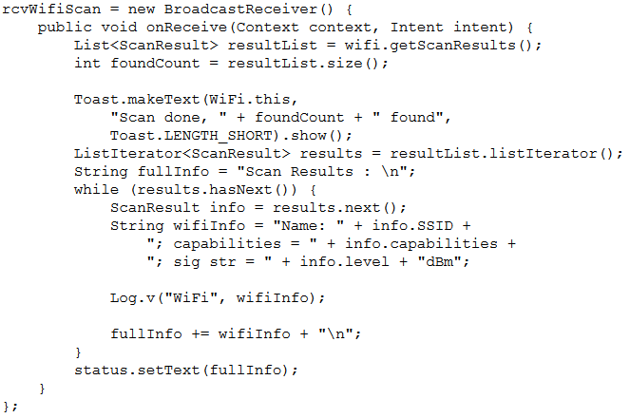
10. Working with Wi-Fi
Monitoring Wi-Fi State
Wi-Fi scan code

Slide 27
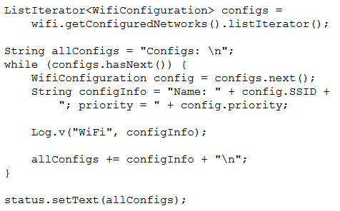
10. Working with Wi-Fi
Monitoring Wi-Fi State
list known access points
Example
Book’s Code:
Chapter 16 - Hardware APIs\SimpleWireless

